Slide 1





Institute Achievements
NBA Accreditation
Year: 2025 TO 2028
Computer Engineering
Biomedical Engineering
Year: 2023 TO 2026
Year: 2025 TO 2028
CA-CDDM
Information Technology
Year: 2023 TO 2026
Year: 2025 TO 2028
Civil Engineering
Electronics and communication
Engineering
Year: 2025 TO 2028

Slide 2
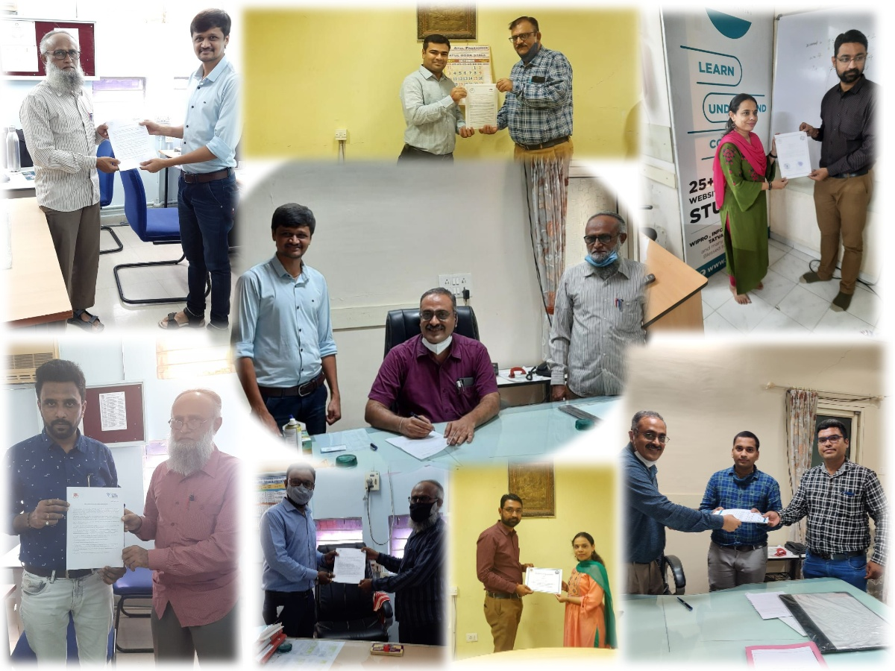
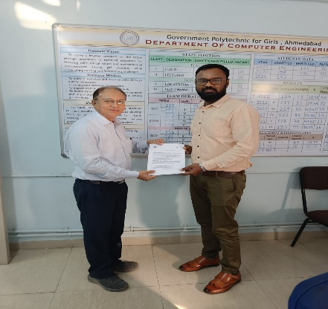

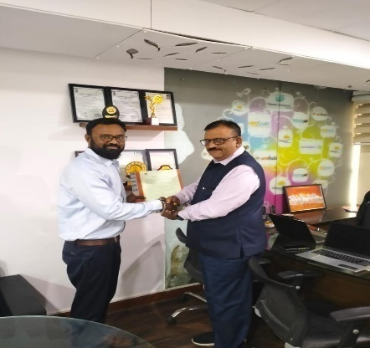
MOUs
PROGRAMME | NUMBER OF MOUs
 | 2021-2022 | 2022-2023 | 2023-2024
Biomedical Engineering | 1 | 2 | 0
Civil Engineering | 1 | 0 | 0
Computer Engineering | 4 | 4 | 3
Electronic & Communication Engg. | 3 | 3 | 7
Information Technology | 3 | 3 | 0
CADDM | 2 | 2 | 2
Architectural Assistantship | 2 | 0 | 0
Information & Communication Technology | 0 | 2 | 0
Total | 16 | 16 | 12
A total of 44 MoUs have been signed with various industries and organizations across different sectors.
In 2023, the institute partnered with Quest Alliance to set up a Language Lab with 15 donated computers along with essential accessories.
Notes:
The institute signed MoUs with various industry sectors to enhance industry-academia collaboration, provide hands-on training, improve employability skills, facilitate internships, and promote knowledge exchange for students and Industry experts.
Quest Alliance has conducted various activity for students like: Session on Gender perspective and Career options, Provision of My Book and Placement Handbook, Establishment of Language lab, Mobile Recharge support to Needy Students,(410), Orientation session on self Employment, Guest lecture on gender through Career Lenses and SEED funding to Learners ( 10000 Rs to 5 Deserving female learners to kickstart their entrepreneurial venture)

Slide 3





Projects under MHRD and GoG
No. of Beneficiaries-2765
No. of Beneficiaries-1400
No. of Beneficiaries-1620
SPPWD
(Scheme of Polytechnic
For Persons
With Disabilities)
No. of Beneficiaries-131
No. of Beneficiaries-40
Notes:
Training & Placement: Various Activity like job readiness program, campus placement activity ( Placement fair and On campus placement), Internship
RUSA: Gender sensitization program, equal opportunity cell, sanatory napkin distribution, expert sessions on time management and importance of nutritional on women health.
SSIP: Sensitization program, Awareness of government scheme for Start up and patent filling, funding to PoC
Finishing School: English Learning, Personality Development
SSPPWD: various activity to disable person to make them self dependent.

Slide 4

Institute Rank In Gujarat Technological University
Institute Rank | Institute Result (%) | GTU Result (%) | Semester | Exam
5th | 44.8 | 27.58 | 1st | Winter-2023
1st | 64.9 | 32.59 | 3rd | Winter-2023
6th | 80.47 | 64.62 | 5th | Winter-2023
6th | 49.2 | 32.16 | 2nd | Summer-2024
2nd | 77.72 | 48.8 | 4th | Summer-2024
6th | 89.29 | 73.5 | 6th | Summer-2024
Over the last three years, our institute rank has been consistently within the top 10 among all Polytechnic institutes (Govt. & SFI) affiliated with GTU

Slide 5

Faculty Achievements
Sr. No. | Achievements | Total
1 | Ph.D. Completed | 3
2 | Ph.D. Pursuing | 7
3 | M.E. Completed | 3
4 | DRC Member | 1
3 | Faculties associated with curriculum revision committee | 28
4 | Expert lecture conducted in other institute | 5
5 | Paper published/ Presented | 8
6 | Member of B.O.S. committee | 8
7 | Duties Performed as Judge/ Jury in Hackathon | 41
8 | GTU/DTE inspection committee member | 3
9 | DTE Level Portfolio / NBA mentorship | 8
10 | Education Department level portfolio (ACPDC, FRC) | 5

Slide 6

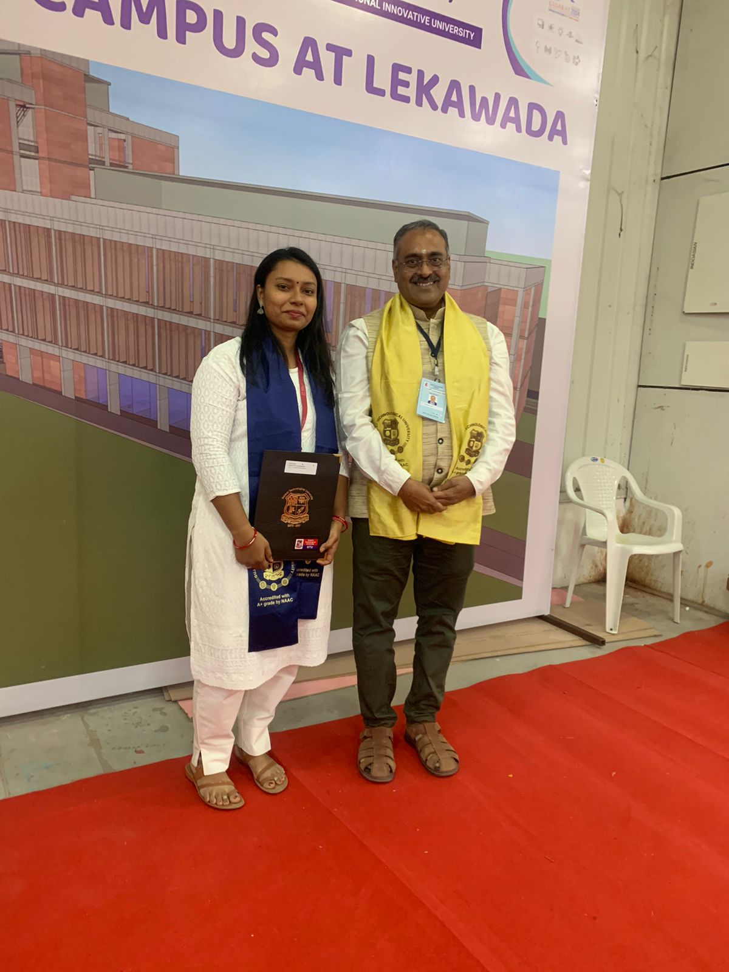
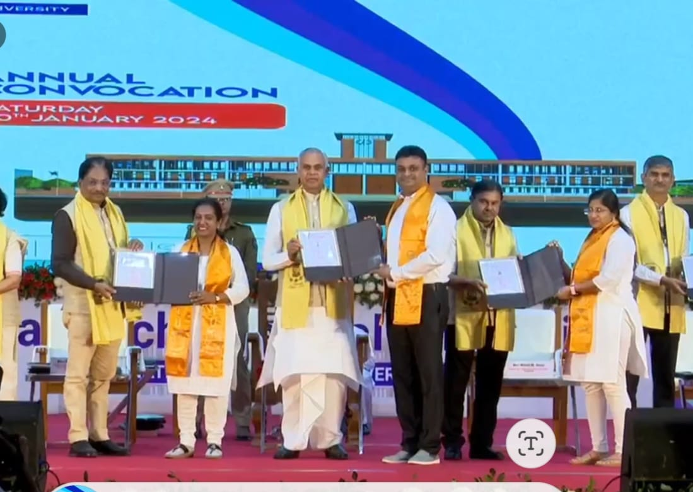
Faculty Achievements (PhD & Masters)
Mr. Dipesh Dalal awarded
‘Ph.D. in Civil’ by honourable Governor of Gujarat Acharya Devvrat ji
on 20-01-2024
Ms. Aarti Dalwadi ,Lecturer in BM, did her masters and awarded with Gold Medal at GTU convocation-2024

Slide 7
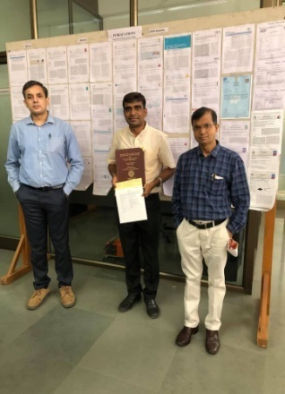
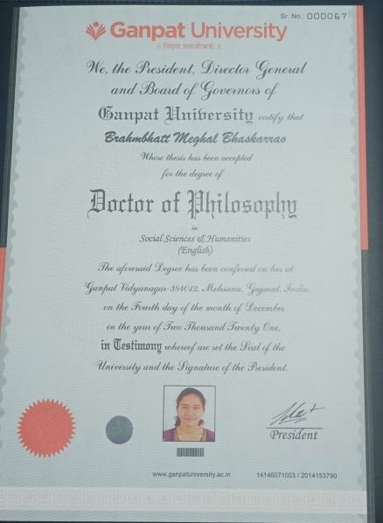
Faculty Achievements (PhD)
Ms. Meghal Brahmbhatt awarded
‘Ph.D. in English’ by Ganpat University
on 2nd December 2021
Mr. Arvind Chavda awarded ‘Ph.D. in
Physics’ (Condensed matter Physics) by
Pandit Deendayal Energy University,
Gandhinagar, Gujarat on 6th July 2021

Slide 8
Faculty Achievements (PhD)
The following faculty members have received notification of their Ph.D. degree:
  Mrs. Jasmin Karagthala – Lecturer, CE
  Mrs. Rikita Parekh – Lecturer, IT
  Mr. Rakesh Motka – Lecturer, Bio

Slide 9
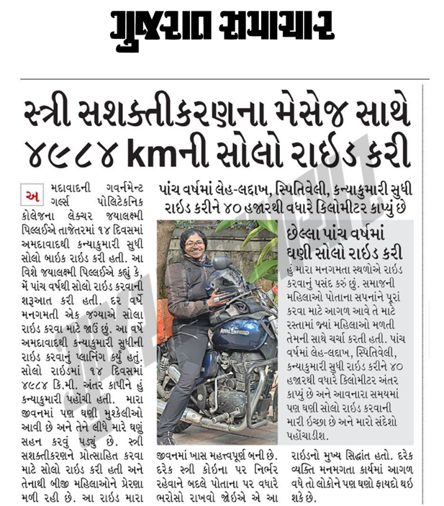
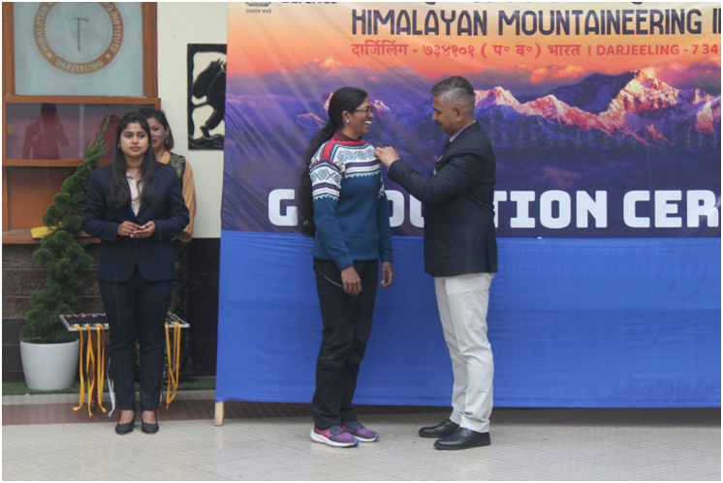
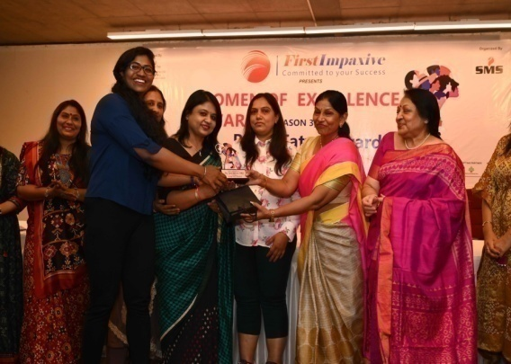
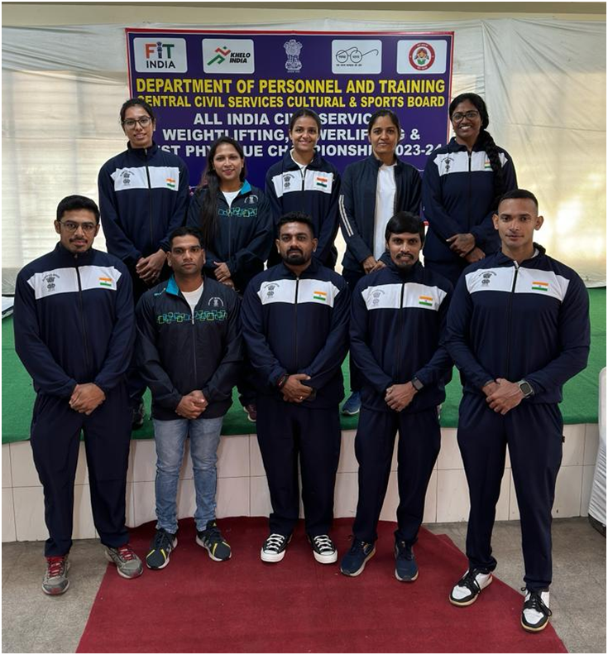
Faculty Achievements
Featured in Gujarat Samachar for solo bike riding from Ahmedabad to Kanyakumari coastal ride
Successfully completed Advance Mountaineering Course from Himalayan Mountaineering Institute, Darjeeling
  “Woman of Excellence Award2022” to Ms. Jaya Pillai on 8th March 2022 by former Mayor of Ahmedabad, Meenakshiben Patel
Represented Gujarat at All India Civil Services 2023-24 - Powerlifting Event, Placed 5th position in 76kg class
Notes:
This faculty member is currently on a journey to conquer Mount Everest.

Slide 10
Faculty Achievements (Publication)
Faculty Name | Paper Title | Journal | Publication Year
Dipesh H Dalal Author | Contribution by various authors to detect leakage from water distribution network Leakage detection in water distribution networks using WSN in smart cities. | 1st International Conference on "Advances in Water Treatment and Management organized by PDEU, Gandhinagar. (ICAWTM-22)" on 25th- 26th March, 2022 organized by Pandit Deendayal Energy University, Gandhinagar, Gujarat, INDIA | 25-03- 2022
Rakesh Motka Author | Comprehensive Review on Prediction of Blood Glucose Level in Type-1 Diabetic Using Machine Learning Techniques. Optimizing Blood Glucose Prediction Accuracy in Type-1 Diabetes with a Stacked LSTM Universal Model. | International Joint Conference on Advances in Computational Intelligence IJCACI 2023, ISBN978-981-97-0180-3, Springer Singapore publication Journal of Information system Engineering and Management, ISSN (Online): 2468-4376, Scoups Indexed | 14-10-2023 19-01-2025
Zarana R. Shah Co-Author | Scheduling and Optimization of Traffic Lights in Vanet VANET Traffic Congestion Detection and Avoidance | International Journal on Recent and Innovation Trends in Computing and Communication (IJRITCC) [UGC CARE Approved ISSN Number- 2321-8169] International Journal on Recent and Innovation Trends in Computing and Communication (IJRITCC) [UGC CARE Approved ISSN Number- 2321-8169] | Feb-2023 Aug-2022

Slide 11
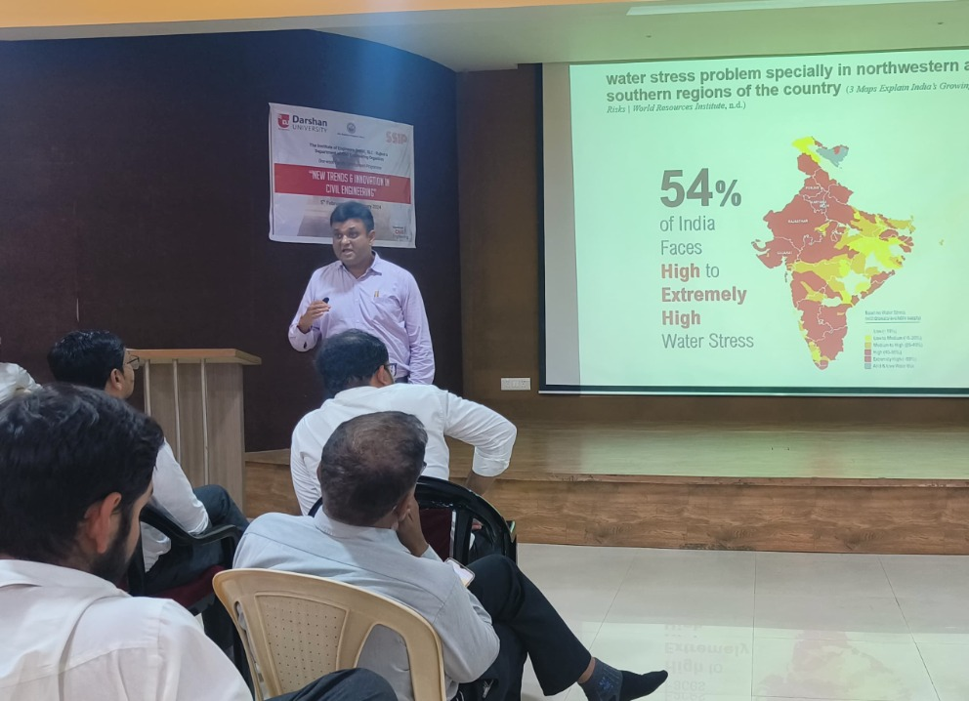
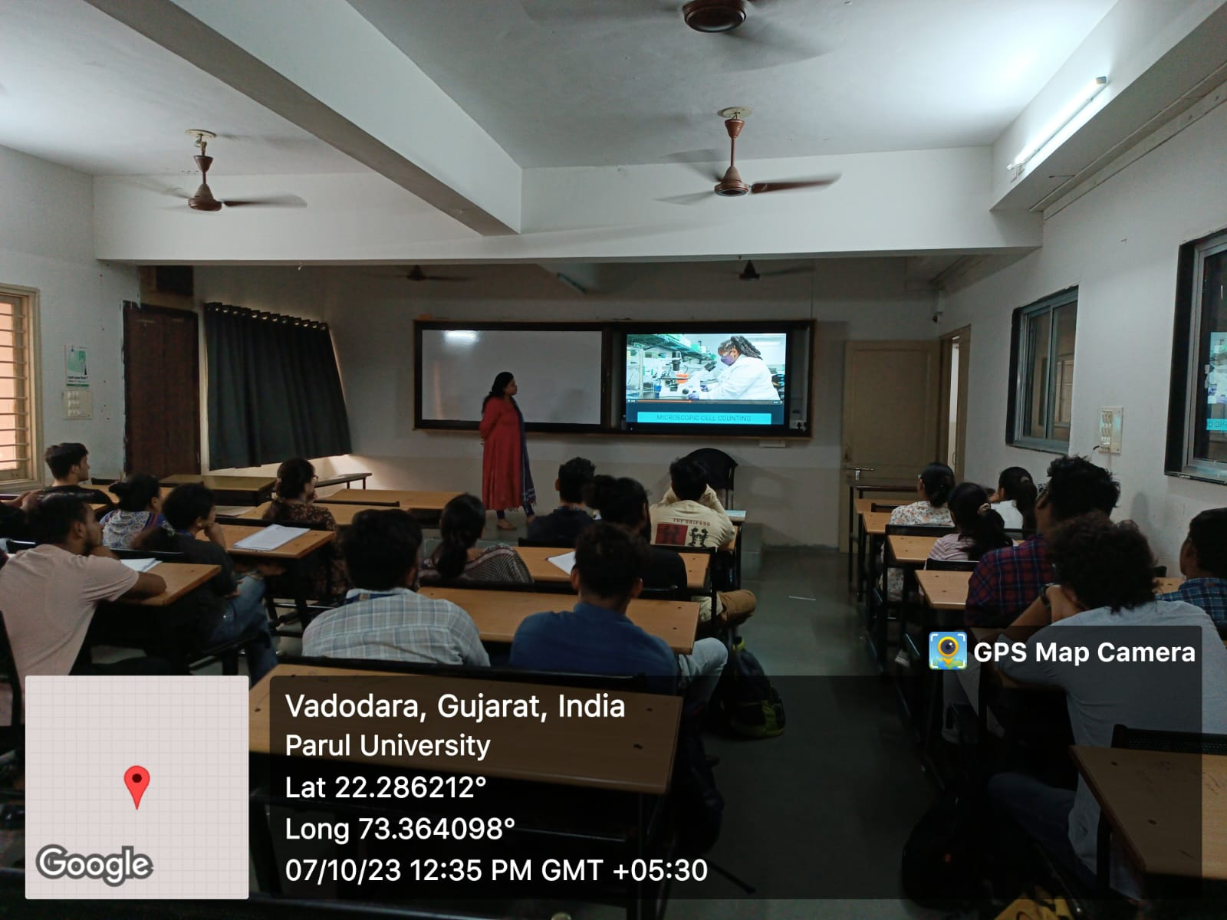
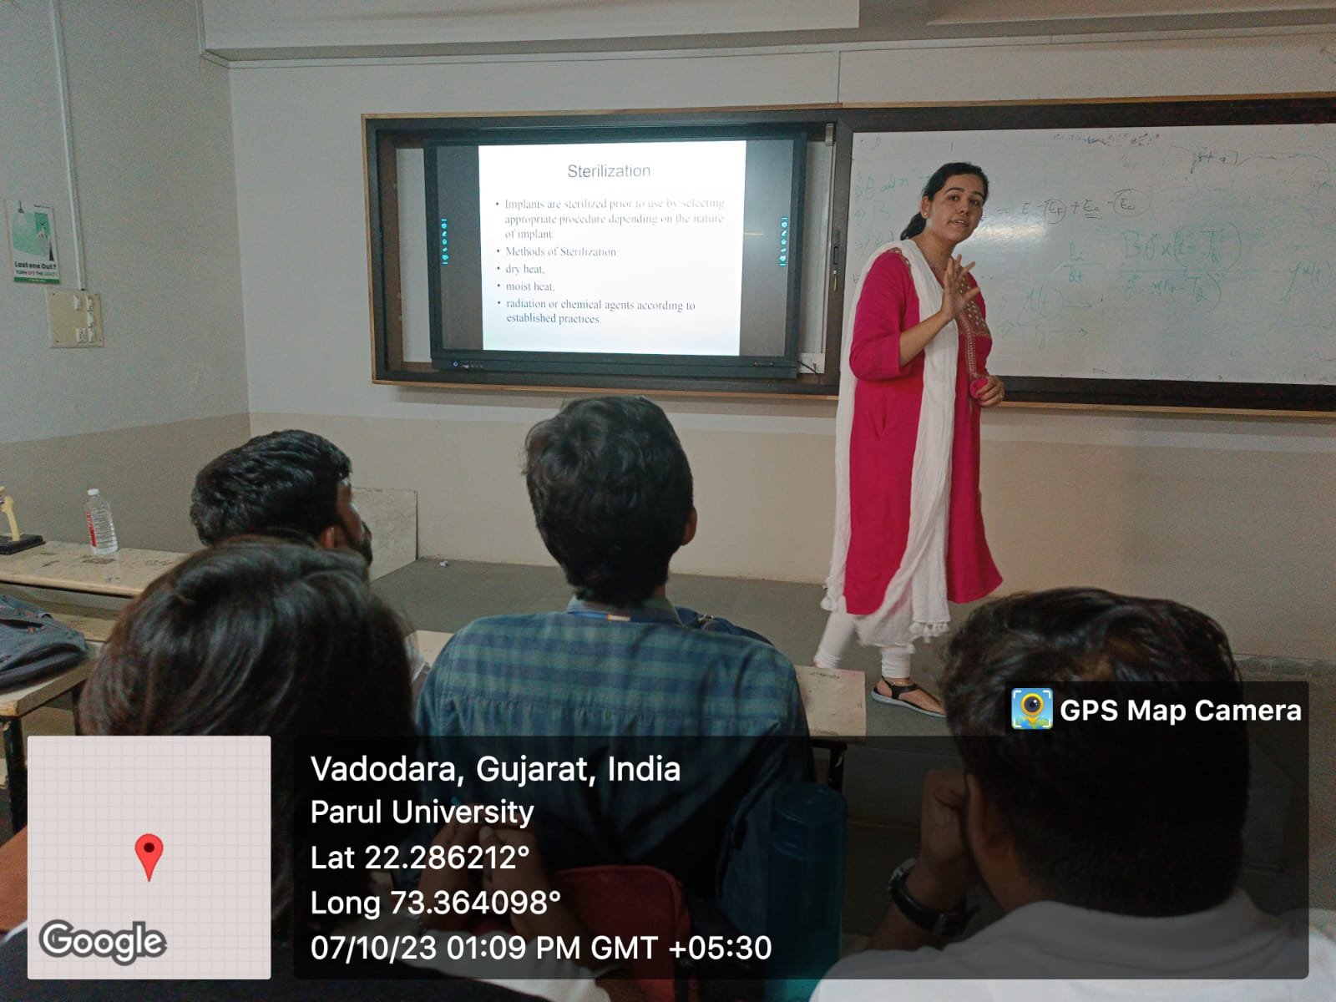
Faculty Achievements ( Expert Sessions )
Faculty Name | Expert Session | Organization | Date
Dipesh H Dalal | Expert Lecture Delivered in STTP “New trends and innovations in Civil Engineering” | Darshan University | 06/02/2024
Meghana M Patel | Expert Session on "Analytical Techniques And Instrumentation" | Parul University | 07-10-2023
Neelam B Modi | Expert Session on "Biomaterials And Implants" | Parul University | 07-10-2023
Chaitali J. Vaghela | Online Expert session on “Web Service Demonstration” | GP, Himmatnagar | 04/11/2023

Slide 12
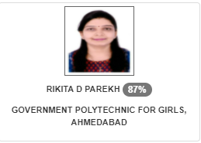
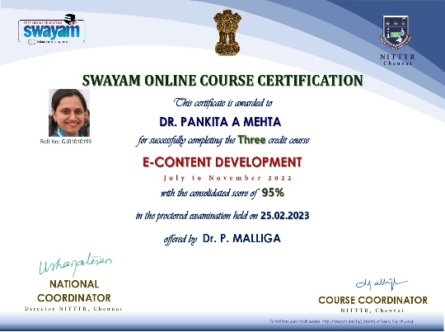
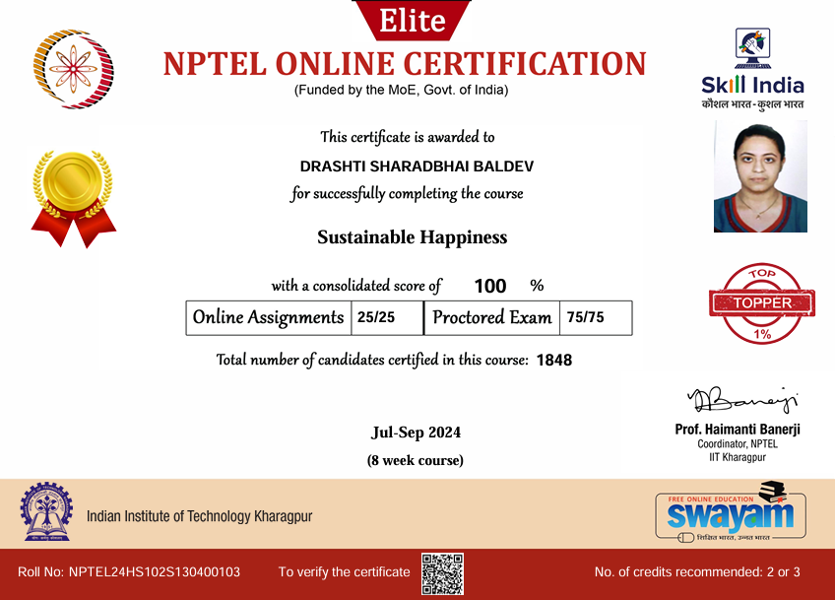
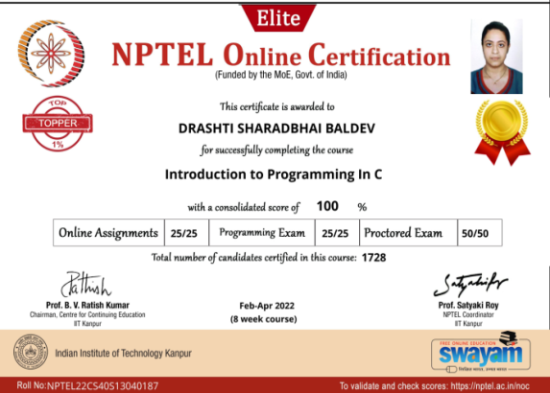
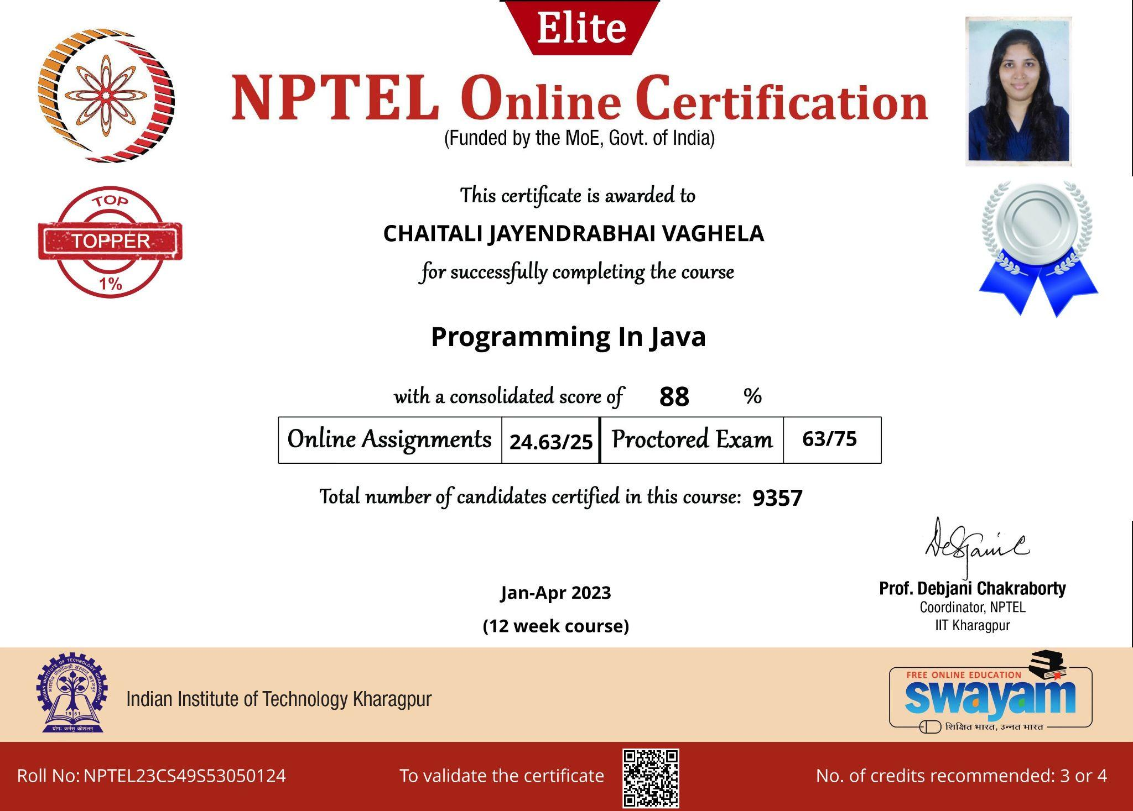
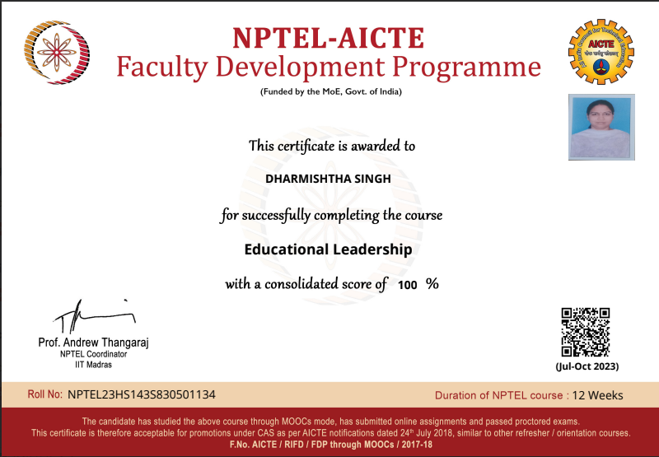
Faculty Achievements (NPTEL & MOOC)
Ms. Rikita Parekh was listed in top 1% list by NPTEL online certification course in 2021 -22
Dr. Pankita Mehta score 95% In SWAYAM online Course “ E-Content Development” 2023
Ms. Drashti S. Baldev was listed in top 1% with 100% score by NPTEL online certification course in 2024
Ms. Drashti Baldev was listed in top 1% list by NPTEL online certification course in 2021 -22
Ms. Chaitali J Vaghela was listed in top 1% among 9357 candidates with score 88% by NPTEL online certification course in 2023
Ms. Dharmistha S. Singh was listed in
top 1% with 100% score by NPTEL online certification course in 2024
Notes:
41 Faculty members have undertaken 63 various trainings organized by DTE, various Institutes, NPTEL, MOOC, etc. on both online and offline modes with an aim to improve their skills.

Slide 13
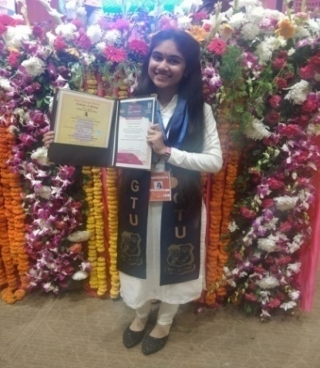
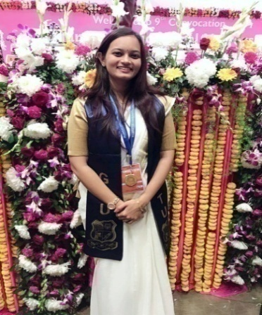
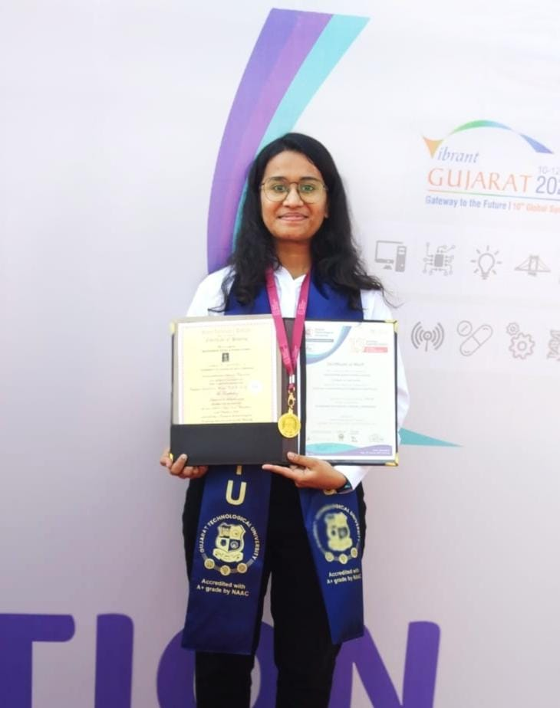
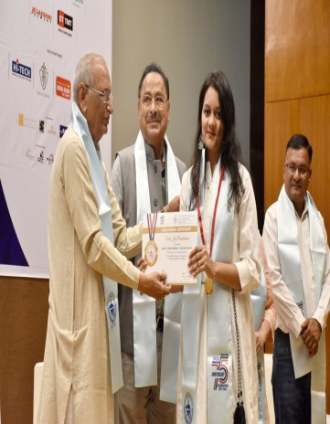
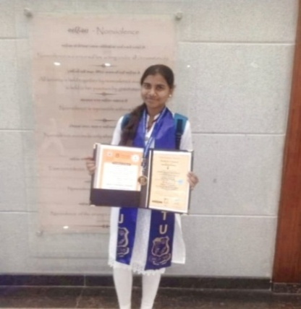
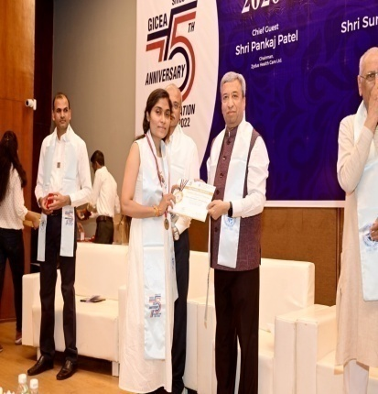
Student Curricular Achievements
Program | Student | Achievement
EC | Israni Sonali | 7th Rank In GTU Top Ten Students 2022
EC | Shah Honey P | 3rd Rank In GTU Top Ten Students 2023
EC | Samdhiya Snehal P | 9th Rank In GTU Top Ten Students 2024
Computer | Panchal Namasvi D. | 1st Rank in GTU TOP 10 all branch (Sem-II)
Computer | Kikani Hely Nileshbhai | 8th Rank GTU TOP 10 all branch in (Sem VI)
CACDDM | Shaikh Ujma M | 5th Rank In GTU Top Ten Students 2023
CACDDM | Mulani Snehal K | 9th Rank In GTU Top Ten Students 2024
IT | Maheshwari Ritika J. | Awarded with gold medal in year 2023
IT | Maheshwari Ritika J. | 1st Rank in GTU Top 10
In GTU Summer 2023 Examination, Government Polytechnic for Girls, Ahmedabad was ranked first in all over Gujarat.
In GTU Winter 2023 Semester 3 Examination , Government Polytechnic for Girls, Ahmedabad was ranked first in all over Gujarat.

Slide 14
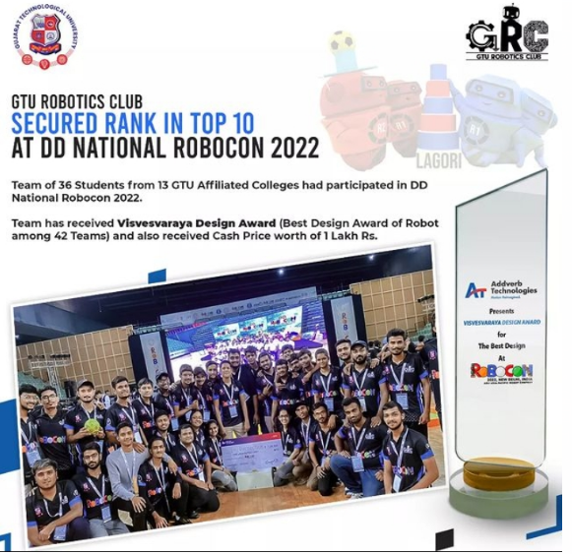
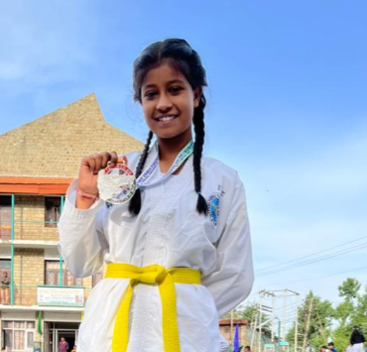
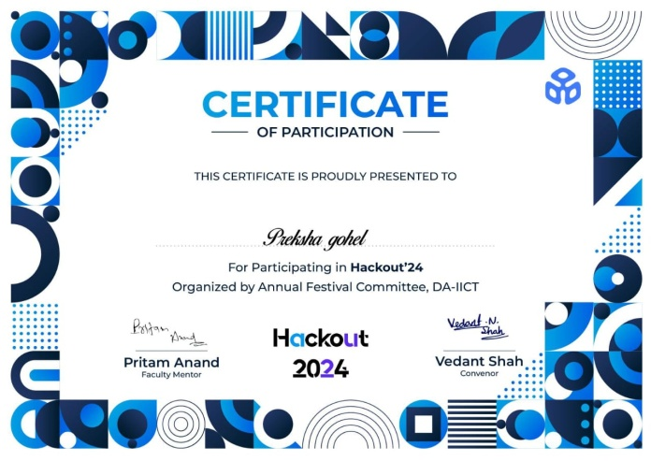
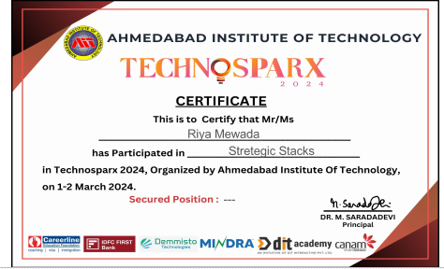
Student Co-Curricular Achievements
Shreya Chaturvedi of IT department won a Silver Medal in 31st North & East INDIA TAEKWON-DO ITF Championship under Fit India, Khelo India in 2022
Detroja Heli from Computer Department and her team from GTU has secured ninth rank at DD National Robocon 2022

Slide 15
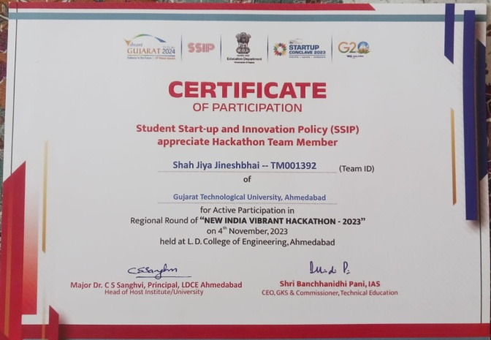
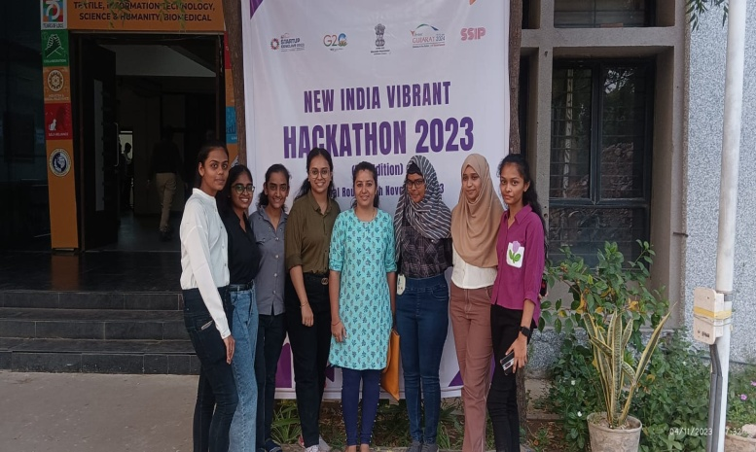
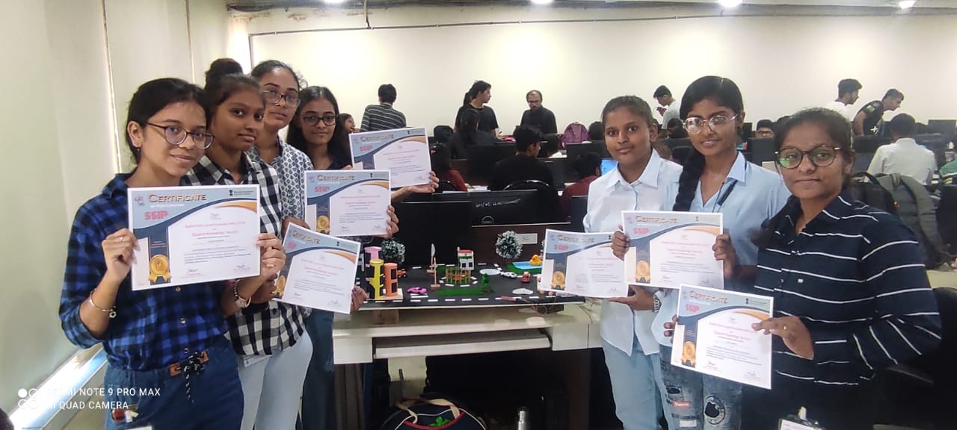
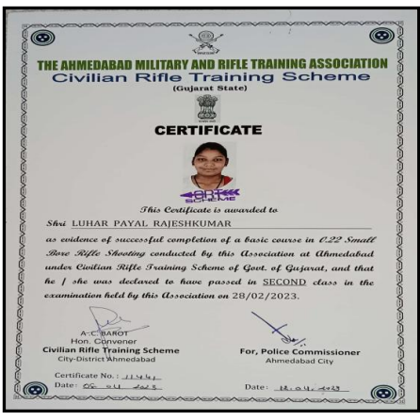
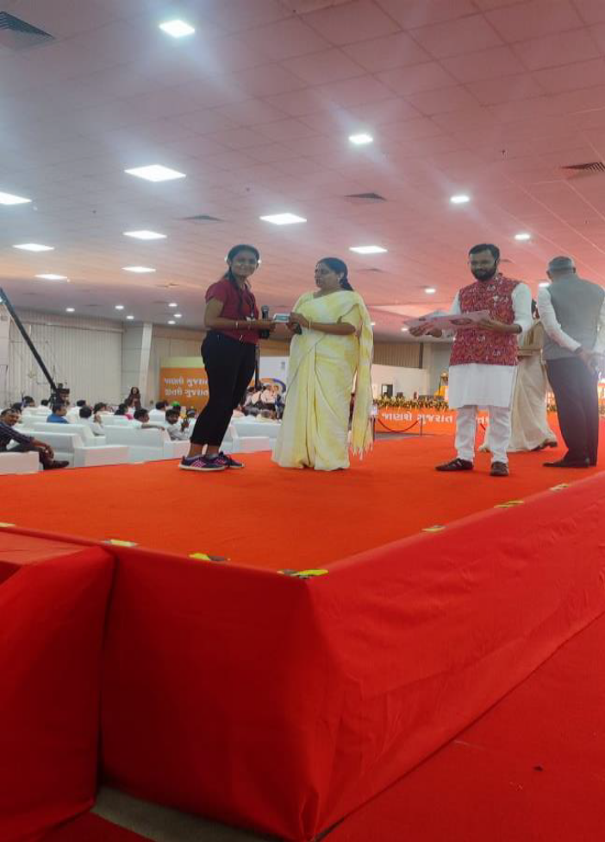
Student Co-Curricular Achievements
Hackathon-2023
Hackathon-2022
Nayak Shruti CACDDM Winner of G3Q 2022-2023
Luhar Payal got 2nd class in the examination held by civilian rifle training scheme
Notes:
Our students are actively participating in hackathon “ state level competition” for problem solving.

Slide 16
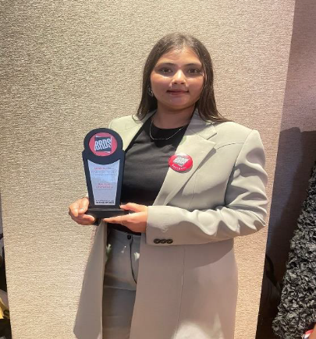
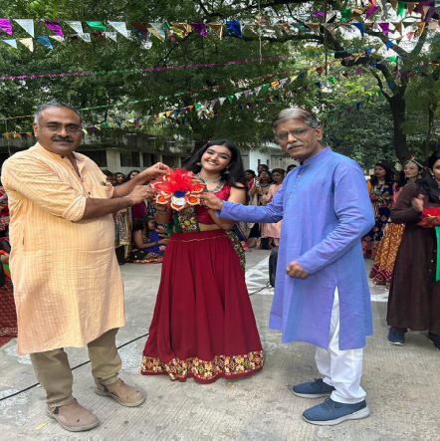
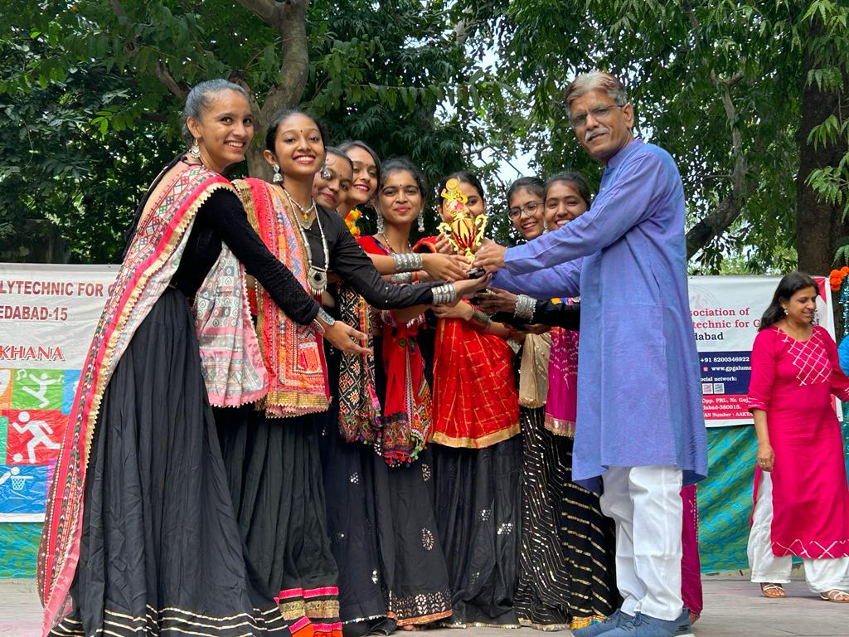
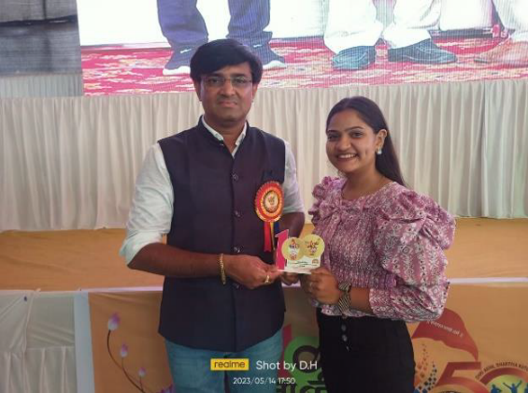
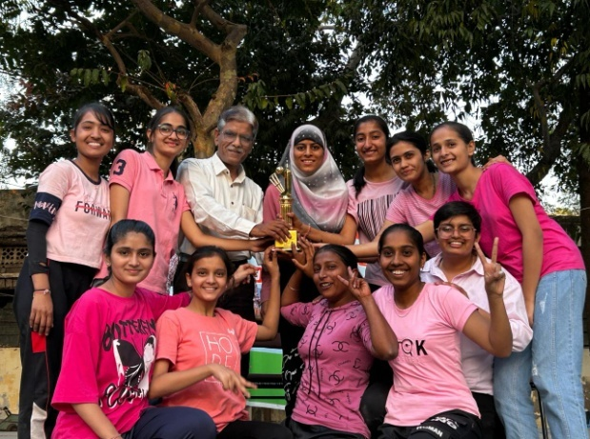
Student Co-Curricular Achievements
Ayesha Hasihasrwala-Best Ayant Garde Collection-BRDS Award Function
Vivitsa Makwana-Winner of Garba-Best Action Gopi Rass
2022-2023
Winner of Interdepartmental Garba in Gopi Ras (2023-24)
Computer Dept. Cricket Champion – 2023 & 2024
Patel Yashwi (CACDDM) awarded best Anchor in 2021-22

Slide 17

Faculty Development Program
Year | 2019 | 2020 | 2021 | 2022 | 2023 | 2024 | Total
No. of Trainings | 100 | 234 | 70 | 51 | 113 | 92 | 660
No. of faculties trained | 54 | 83 | 50 | 45 | 59 | 63 | 354
In the year 2024, a total of 59 faculty members participated in a 3-week industrial training program.

